Slide 1
Exploring Feature Reduction Techniques for Indic Script Text Clustering
16011A0501 – Abhay A Bhat
16011A0521 – Priyatosh Tripathy
16011A0524 – V. Sai Nagendra

Slide 2
Text clustering and its uses:
Applying cluster analysis on unstuctured text data using techniques from machine learning and NLP.
Automatic document organization.
Topic extraction.
Information retrieval.
Filtering.

Slide 3
Text Processing problems with Indic languages.
Morphology is richer and word order is flexible.
Indic languages are highly inflective.

Slide 4
Dataset
In this project the dataset used consists of 141 Telugu documents from various sources belonging to sports, political news, literature.
There are 47 documents pertaining to each group.
Total words: 18872
Average words per documents: 134
Average words per group: 6163

Slide 5
Preprocessing
Noise removal is done by removal of numbers and punctuation.
Stopword removal and Stemming are difficult because Indic languages are highly inflictive i.e the words are combined to produce a meaning.
Prefix and suffix removal may change the meaning.
Hence highly frequent words and very rare words are removed.

Slide 6
Document representation
Document representation is concerned about how textual documents should be represented in various tasks,
Its prevailing approach is the vector space model. Ex: TF-IDF

Slide 7
TF-IDF
Tf-idf stands for term frequency-inverse document frequency.
TF(t) = (Number of times term t appears in a document) / (Total number of terms in the document).
IDF(t) = loge(Total number of documents / Number of documents with term t in it).

Slide 8
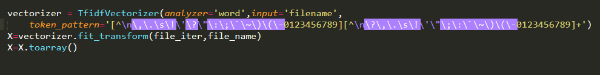
TF-IDF - implementation
Python implementation: sklearn.feature_extraction.text.TfidfVectorizer

Slide 9
Dimensionality Reduction
Process of dimensionality reduction by which an initial set of raw data is reduced to more manageable groups.
Dimensionality techniques used in this project:
PCA
K-PCA(linear, polynomial, cosine,sigmoid)

Slide 10
Advantage of Dimensionality Reduction
High-dimensional datasets present many mathematical challenges.
Machine learning methods are computationally expensive hence high dimensionality can increase costs.
Not all attributes are important hence dimensionality reduction can remove the unwanted attributes keeping only the important ones.
Optimal reduction in dimensionality can reduce the inefficient computations and thus reduce the computation time.

Slide 11

Principal Component Analysis
PCA is a statistical procedure that uses orthogonal transformation to convert a set of observations of co-related variables into a set of values of linearly uncorrelated variables called principal components.
Python implementation: sklearn.decomposition.PCA

Slide 12
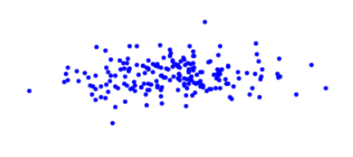
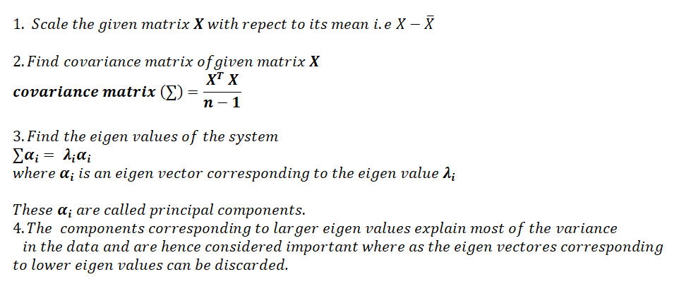
Steps included in PCA:
PC1
PC2

Slide 13

Kernel - PCA
PCA is a linear method.
Creates linearly independent vectors, so there is no covariance on which to perform eigen-decomposition explicitly as we would in linear PCA.
Python implementation: sklearn.decomposition.KernelPCA

Slide 14
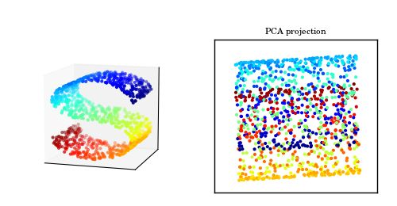
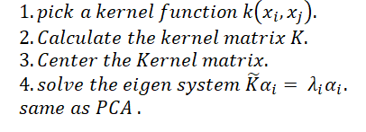
Steps in K-PCA

Slide 15
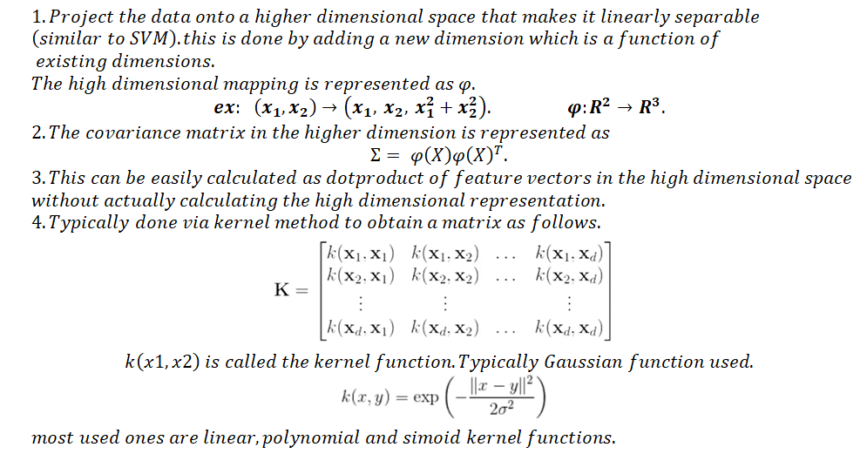
Kernel function in K-PCA

Slide 16

K-means
Clustering algorithm based on distance similarities.
Aim:
Inter-cluster distance is maximum.
Intra-cluster distance is minimum.

Slide 17


Cluster Evaluation scores
Adjusted rand index.
V-measure.

Slide 18


Adjusted Rand score:
Rand index:
Adjusted rand score:
ARI = (RI - Expected_RI) / (1- Expected_RI)

Slide 19
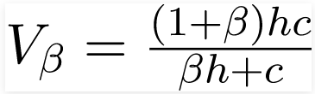
V-measure
It is calculated as the weighted harmonic mean of completeness and homogeneity.

Slide 20
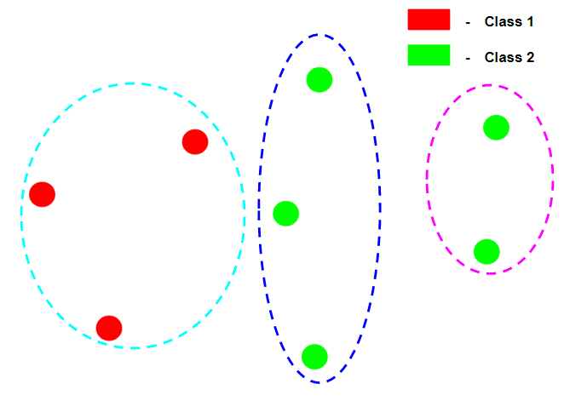
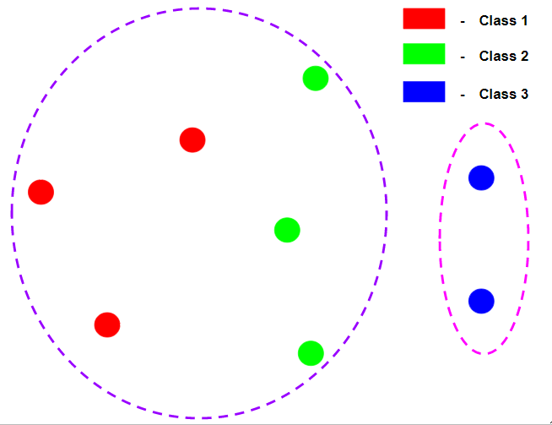
V-measure
homogeneity
completeness
A clustering result satisfies homogeneity if all of its clusters contain only data points which are members of a single class.
A clustering result satisfies completeness if all the data points that are members of a given class are elements of the same cluster.

Slide 21
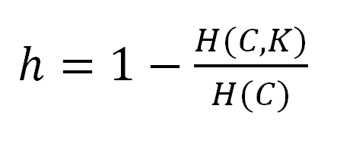
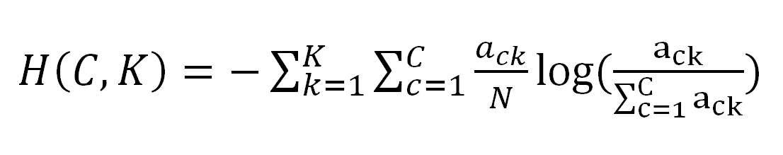
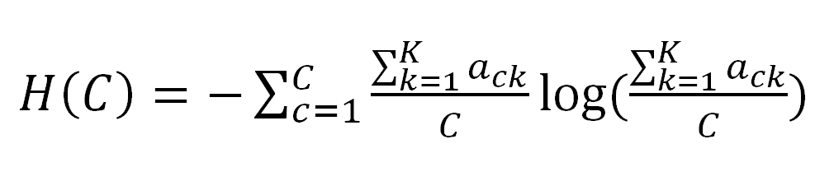
Homogeneity score

Slide 22
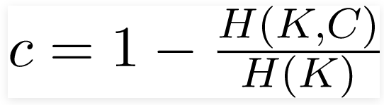
Completeness score

Slide 23
Comparing clustering efficiencies.
 | Kernel function | num features | ARI | V- measure | Time* (in sec)
tfidf | none | 18872 | 0.2781 | 0.3028 | 1.8380
pca | none | 141 | 0.2303 | 0.2889 | 0.8647
K-pca | linear | 141 | 0.3207 | 0.3300 | 0.0768
K-pca | polynomial | 141 | 0.3589 | 0.4142 | 0.0777
K-pca | cosine | 141 | 0.3702 | 0.3608 | 0.1047
K-pca | sigmoid | 141 | 0.3374 | 0.3463 | 0.0787

Slide 24
Comparing reduction of features over clustering efficiencies
num features | DR(in %)* | ARI | V-measure
141 | 0 | 0.2303 | 0.2889
136 | 3.5461 | 0.3702 | 0.3608
131 | 7.0921 | 0.3480 | 0.3958
126 | 10.6382 | 0.2709 | 0.3290
121 | 14.1842 | 0.1599 | 0.3024
PCA:
num features | DR(in %)* | ARI | V-measure
141 | 0 | 0.3589 | 0.4142
136 | 3.5461 | 0.3702 | 0.3608
131 | 7.0921 | 0.3480 | 0.3958
126 | 10.6382 | 0.2709 | 0.3290
121 | 14.1842 | 0.1599 | 0.3024
K-PCA:

Slide 25
CONCLUSION
It is evident that by applying the Feature Selection/dimensionality reduction method with K-Means algorithm there is not much change in the clustering efficiency.
It has also been observed that while running the test data set on K-Means with dimensionality reduction takes lesser time than K-Means with the full data representation to produce similar results.
In future, better stopword removal techniques, stemming and morphological analysis can be used to produce better clustering results.

Slide 26
References
https://medium.com/@dmitriy.kavyazin/principal-component-analysis-and-k-means-clustering-to-visualize-a-high-dimensional-dataset-577b2a7a5fe2
https://www.kaggle.com/arthurtok/principal-component-analysis-with-kmeans-visuals
https://towardsdatascience.com/dimensionality-reduction-for-machine-learning-80a46c2ebb7e
https://en.m.wikipedia.org/wiki/Principal_component_analysis
https://en.wikipedia.org/wiki/Kernel_principal_component_analysis
https://scikit-learn.org/stable/modules/clustering.html#k-means
https://scikit-learn.org/stable/modules/clustering.html#clustering-performance-evaluation

